Slide 1
Sorting and Searching
Initially prepared by Dr. Ilyas Cicekli; improved by various Bilkent CS202 instructors.
CS202 - Fundamentals of Computer Science II

Slide 2
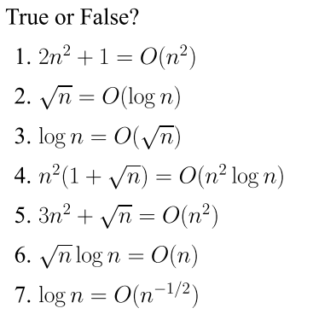
Problem of the Day
CS202 - Fundamentals of Computer Science II

Slide 3
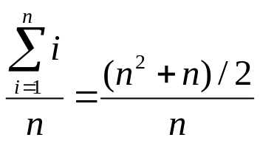
Sequential Search
int sequentialSearch( const int a[], int item, int n){
for (int i = 0; i < n && a[i]!= item; i++);
if (i == n)
return –1;
return i;
}
Unsuccessful Search: ➔ O(n)
Successful Search:
Best-Case: item is in the first location of the array ➔ O(1)
Worst-Case: item is in the last location of the array ➔ O(n)
Average-Case: The number of key comparisons 1, 2, ..., n
➔ O(n)
CS202 - Fundamentals of Computer Science II

Slide 4
Binary Search
int binarySearch( int a[], int size, int x) {
int low =0;
int high = size –1;
int mid; // mid will be the index of
// target when it’s found.
while (low <= high) {
mid = (low + high)/2;
if (a[mid] < x)
low = mid + 1;
else if (a[mid] > x)
high = mid – 1;
else
return mid;
}
return –1;
}
CS202 - Fundamentals of Computer Science II

Slide 5
Binary Search – Analysis
For an unsuccessful search:
  The number of iterations in the loop is ⎣log₂n⎦ + 1 ➔ O(log₂n)
For a successful search:
  Best-Case: The number of iterations is 1 ➔ O(1)
  Worst-Case: The number of iterations is ⎣log₂n⎦ +1 ➔ O(log₂n)
  Average-Case: The avg. # of iterations < log₂n ➔ O(log₂n)
  0 1 2 3 4 5 6 7 ← an array with size 8
  3 2 3 1 3 2 3 4 ← # of iterations
  The average # of iterations = 21/8 < log₂8
CS202 - Fundamentals of Computer Science II

Slide 6
How much better is O(log₂n)?
n O(log₂n)
16 4
64 6
256 8
1024 (1KB) 10
16,384 14
131,072 17
262,144 18
524,288 19
1,048,576 (1MB) 20
1,073,741,824 (1GB) 30
CS202 - Fundamentals of Computer Science II

Slide 7
Sorting
CS202 - Fundamentals of Computer Science II

Slide 8
Importance of Sorting
Why don’t CS profs ever stop talking about sorting?
Computers spend more time sorting than anything else, historically 25% on mainframes.
Sorting is the best studied problem in computer science, with a variety of different algorithms known.
Most of the interesting ideas we will encounter in the course can be taught in the context of sorting, such as divide-and-conquer, randomized algorithms, and lower bounds.
(slide by Steven Skiena)
CS202 - Fundamentals of Computer Science II

Slide 9
Sorting
Organize data into ascending / descending order
  Useful in many applications
  Any examples can you think of?
Internal sort vs. external sort
  We will analyze only internal sorting algorithms
Sorting also has other uses. It can make an algorithm faster.
  e.g., find the intersection of two sets
CS202 - Fundamentals of Computer Science II

Slide 10
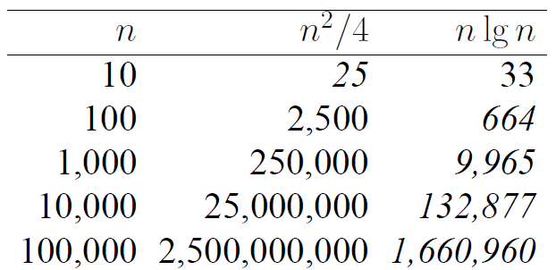
Efficiency of Sorting
Sorting is important because that once a set of items is sorted, many other problems become easy.
Further, using O(n log n) sorting algorithms leads naturally to sub-quadratic algorithms for these problems.
Large-scale data processing would be impossible if sorting took O(n²) time.
(slide by Steven Skiena)
CS202 - Fundamentals of Computer Science II

Slide 11
Applications of Sorting
Closest Pair: Given n numbers, find the pair which are closest to each other.
  Once the numbers are sorted, the closest pair will be next to each other in sorted order, so an O(n) linear scan completes the job. – Complexity of this process: O(??)
Element Uniqueness: Given a set of n items, are they all unique or are there any duplicates?
  Sort them and do a linear scan to check all adjacent pairs.
  This is a special case of closest pair above.
  Complexity?
Mode: Given a set of n items, which element occurs the largest number of times? More generally, compute the frequency distribution.
  How would you solve it?
CS202 - Fundamentals of Computer Science II

Slide 12
Sorting Algorithms
There are many sorting algorithms, such as:
  Selection Sort
  Insertion Sort
  Bubble Sort
  Merge Sort
  Quick Sort
First three sorting algorithms are not so efficient, but last two are efficient sorting algorithms.
CS202 - Fundamentals of Computer Science II

Slide 13
Selection Sort
CS202 - Fundamentals of Computer Science II

Slide 14
Selection Sort
List divided into two sublists, sorted and unsorted.
Find the biggest element from the unsorted sublist. Swap it with the element at the end of the unsorted data.
After each selection and swapping, imaginary wall between the two sublists move one element back.
Sort pass: Each time we move one element from the unsorted sublist to the sorted sublist, we say that we have completed a sort pass.
A list of n elements requires n-1 passes to completely sort data.
CS202 - Fundamentals of Computer Science II

Slide 15
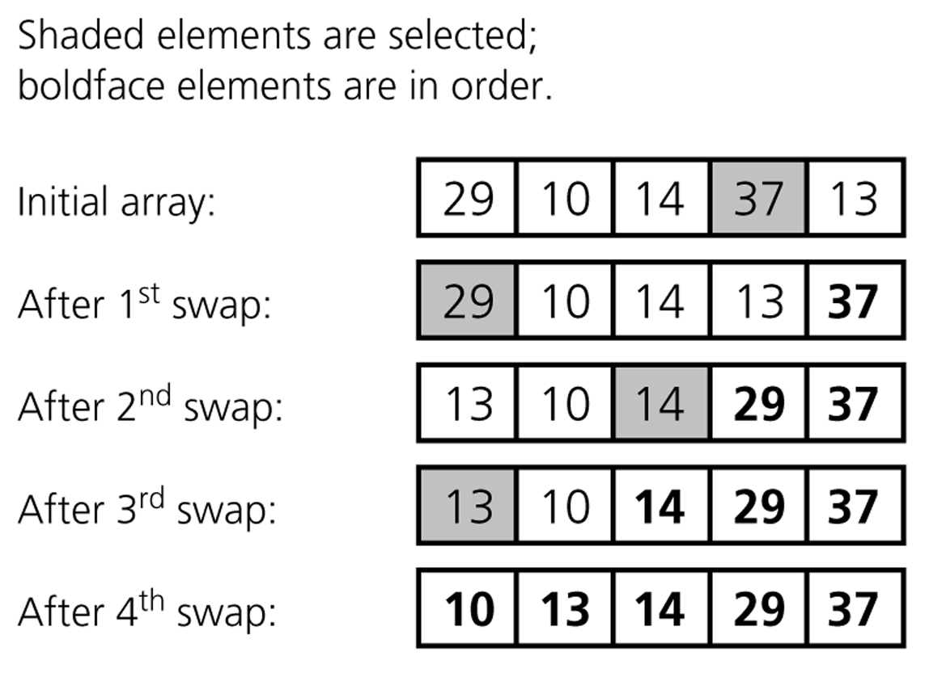
Selection Sort (cont.)
Unsorted Sorted
CS202 - Fundamentals of Computer Science II

Slide 16
Selection Sort (cont.)
typedef type-of-array-item DataType;
void selectionSort( DataType theArray[], int n) {
for (int last = n-1; last >= 1; --last) {
int largest = indexOfLargest(theArray, last+1);
swap(theArray[largest], theArray[last]);
}
}
CS202 - Fundamentals of Computer Science II

Slide 17
Selection Sort (cont.)
int indexOfLargest(const DataType theArray[], int size) {
int indexSoFar = 0;
for (int currentIndex=1; currentIndex<size;++currentIndex)
{
if (theArray[currentIndex] > theArray[indexSoFar])
indexSoFar = currentIndex;
}
return indexSoFar;
}
--------------------------------------------------------
void swap(DataType &x, DataType &y) {
DataType temp = x;
x = y;
y = temp;
}
CS202 - Fundamentals of Computer Science II

Slide 18
Selection Sort -- Analysis
To analyze sorting, count simple operations
For sorting, important simple operations: key comparisons and number of moves
In selectionSort() function, the for loop executes n-1 times.
In selectionSort() function, we invoke swap() once at each iteration.
➔ Total Swaps: n-1
➔ Total Moves: 3*(n-1) (Each swap has three moves)
CS202 - Fundamentals of Computer Science II

Slide 19
Selection Sort – Analysis (cont.)
In indexOfLargest() function, the for loop executes (from n-1 to 1), and each iteration we make one key comparison.
➔ # of key comparisons = 1+2+...+n-1 = n*(n-1)/2
➔ So, Selection sort is O(n²)
The best case, worst case, and average case are the same ➔ all O(n²)
  Meaning: behavior of selection sort does not depend on initial organization of data.
  Since O(n²) grows so rapidly, the selection sort algorithm is appropriate only for small n.
Although selection sort requires O(n²) key comparisons, it only requires O(n) moves.
  Selection sort is good choice if data moves are costly but key comparisons are not costly (short keys, long records).
CS202 - Fundamentals of Computer Science II

Slide 20
Insertion Sort
CS202 - Fundamentals of Computer Science II

Slide 21
Insertion Sort
Insertion sort is a simple sorting algorithm appropriate for small inputs.
  Most common sorting technique used by card players.
List divided into two parts: sorted and unsorted.
In each pass, the first element of the unsorted part is picked up, transferred to the sorted sublist, and inserted in place.
List of n elements will take at most n-1 passes to sort data.
CS202 - Fundamentals of Computer Science II

Slide 22
Insertion Sort (cont.)
Sorted
Unsorted
23 | 78 | 45 | 8 | 32 | 56
23 | 78 | 45 | 8 | 32 | 56
23 | 45 | 78 | 8 | 32 | 56
8 | 23 | 45 | 78 | 32 | 56
8 | 23 | 32 | 45 | 78 | 56
8 | 23 | 32 | 45 | 56 | 78
Original List
After pass 1
After pass 2
After pass 3
After pass 4
After pass 5
CS202 - Fundamentals of Computer Science II

Slide 23
Insertion Sort (cont.)
void insertionSort(DataType theArray[], int n) {
for (int unsorted = 1; unsorted < n; ++unsorted) {
DataType nextItem = theArray[unsorted];
int loc = unsorted;
for ( ;(loc > 0) && (theArray[loc-1] > nextItem); --loc)
theArray[loc] = theArray[loc-1];
theArray[loc] = nextItem;
}
}
CS202 - Fundamentals of Computer Science II

Slide 24
Insertion Sort – Analysis
What is the complexity of insertion sort? ➔ Depends on array contents
Best-case: ➔ O(n)
  Array is already sorted in ascending order.
  Inner loop will not be executed.
  The number of moves: 2*(n-1) ➔ O(n)
  The number of key comparisons: (n-1) ➔ O(n)
Worst-case: ➔ O(n²)
  Array is in reverse order:
  Inner loop is executed p-1 times, for p = 2,3, …, n
  The number of moves: 2*(n-1)+(1+2+...+n-1)= 2*(n-1)+ n*(n-1)/2 ➔ O(n²)
  The number of key comparisons: (1+2+...+n-1)= n*(n-1)/2 ➔ O(n²)
Average-case: ➔ O(n²)
  We have to look at all possible initial data organizations.
So, Insertion Sort is O(n²)
CS202 - Fundamentals of Computer Science II

Slide 25
Insertion Sort – Analysis
Which running time will be used to characterize this algorithm?
  Best, worst or average?
➔ Worst case:
  Longest running time (this is the upper limit for the algorithm)
  It is guaranteed that the algorithm will not be worst than this.
Sometimes we are interested in average case. But there are problems:
  Difficult to figure out average case. i.e. what is the average input?
  Are we going to assume all possible inputs are equally likely?
  In fact, for most algorithms average case is the same as the worst case.
CS202 - Fundamentals of Computer Science II

Slide 26
Bubble Sort
CS202 - Fundamentals of Computer Science II

Slide 27
Bubble Sort
List divided into two sublists: sorted and unsorted.
The largest element is bubbled from the unsorted list and moved to the sorted sublist.
After that, the wall moves one element back, increasing the number of sorted elements and decreasing the number of unsorted ones.
One sort pass: each time an element moves from the unsorted part to the sorted part.
Given a list of n elements, bubble sort requires up to n-1 passes (maximum passes) to sort data.
CS202 - Fundamentals of Computer Science II

Slide 28
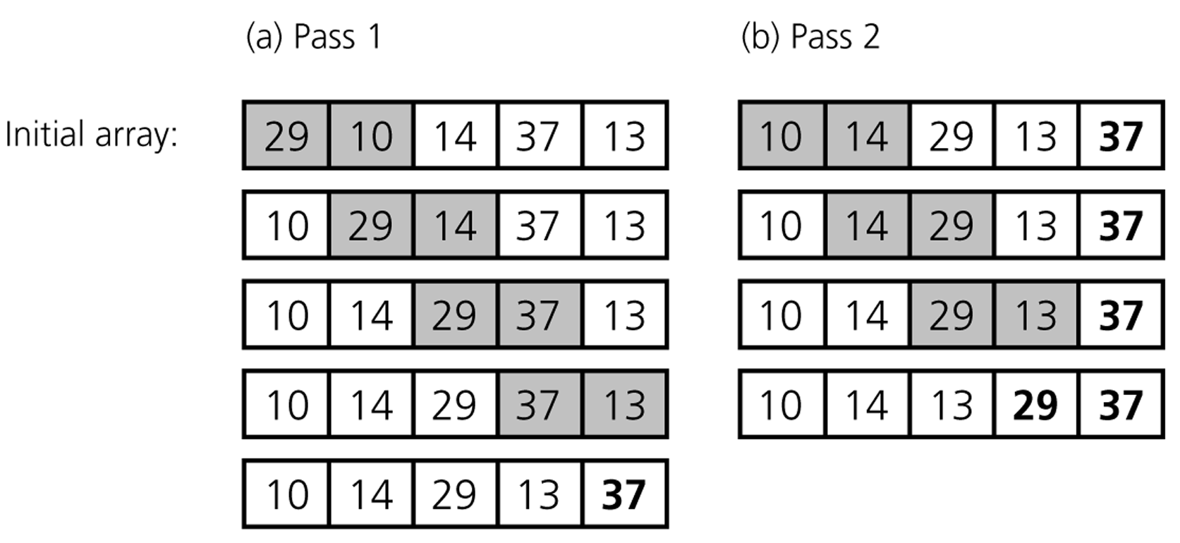
Bubble Sort (cont.)
CS202 - Fundamentals of Computer Science II

Slide 29
Bubble Sort (cont.)
void bubbleSort( DataType theArray[], int n) {
bool sorted = false;
for (int pass = 1; (pass < n) && !sorted; ++pass) {
sorted = true;
for (int index = 0; index < n-pass; ++index) {
int nextIndex = index + 1;
if (theArray[index] > theArray[nextIndex]) {
swap(theArray[index], theArray[nextIndex]);
sorted = false; // signal exchange
}
}
}
}
CS202 - Fundamentals of Computer Science II

Slide 30
Bubble Sort – Analysis
Worst-case: ➔ O(n²)
  Array is in reverse order:
  Inner loop is executed n-1 times,
  The number of moves: 3*(1+2+...+n-1) = 3 * n*(n-1)/2 ➔ O(n²)
  The number of key comparisons: (1+2+...+n-1)= n*(n-1)/2 ➔ O(n²)
Best-case: ➔ O(n)
  Array is already sorted in ascending order.
  The number of moves: 0 ➔ O(1)
  The number of key comparisons: (n-1) ➔ O(n)
Average-case: ➔ O(n²)
  We have to look at all possible initial data organizations.
So, Bubble Sort is O(n²)
CS202 - Fundamentals of Computer Science II

Slide 31
Merge Sort
CS202 - Fundamentals of Computer Science II

Slide 32
Mergesort
One of two important divide-and-conquer sorting algorithms
  Other one is Quicksort
It is a recursive algorithm.
  Divide the list into halves,
  Sort each half separately, and
  Then merge the sorted halves into one sorted array.
CS202 - Fundamentals of Computer Science II

Slide 33
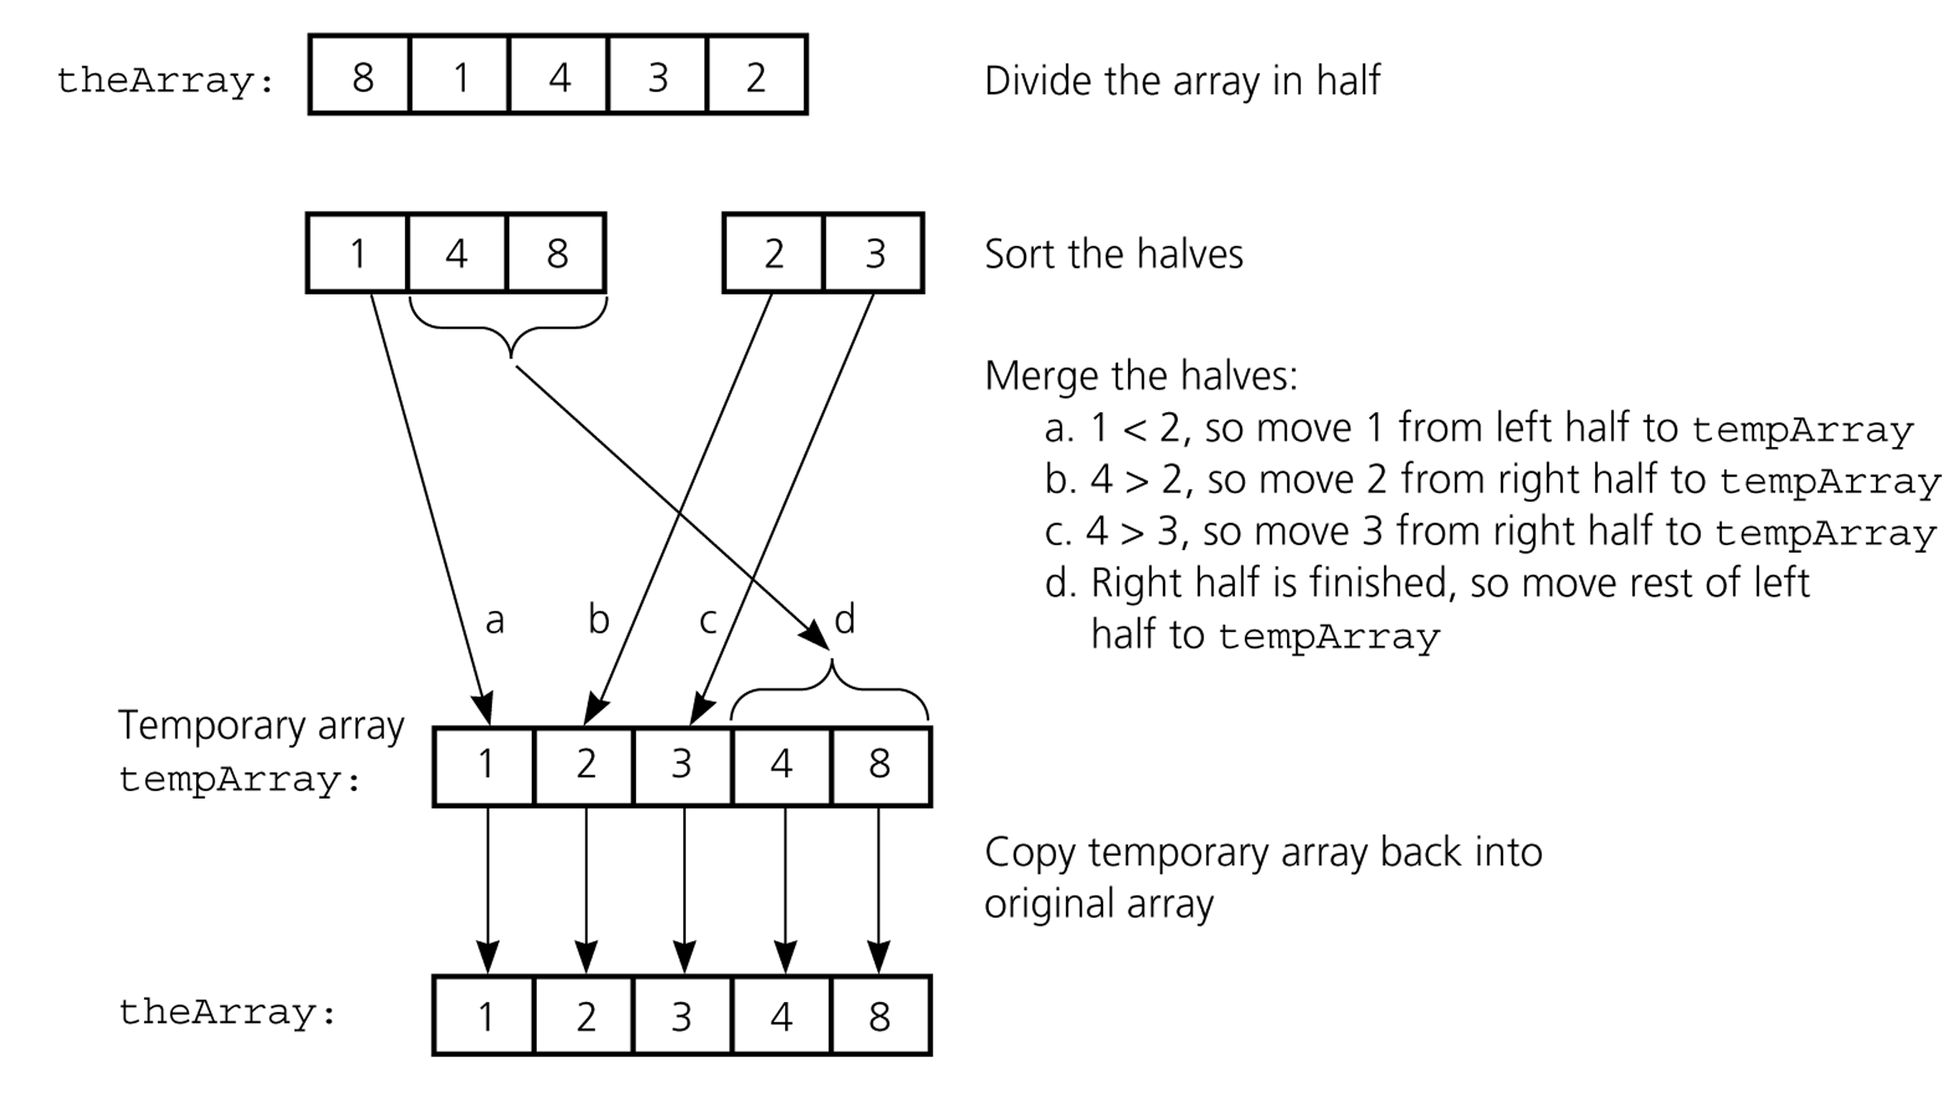
Mergesort - Example
CS202 - Fundamentals of Computer Science II

Slide 34
Mergesort
void mergesort( DataType theArray[], int first, int last) {
if (first < last) {
int mid = (first + last)/2; // index of midpoint
mergesort(theArray, first, mid);
mergesort(theArray, mid+1, last);
// merge the two halves
merge(theArray, first, mid, last);
}
} // end mergesort
CS202 - Fundamentals of Computer Science II

Slide 35
Merge
const int MAX_SIZE = maximum-number-of-items-in-array;
void merge( DataType theArray[], int first, int mid, int last) {
DataType tempArray[MAX_SIZE]; // temporary array
int first1 = first; // beginning of first subarray
int last1 = mid; // end of first subarray
int first2 = mid + 1; // beginning of second subarray
int last2 = last; // end of second subarray
int index = first1; // next available location in tempArray
for ( ; (first1 <= last1) && (first2 <= last2); ++index) {
if (theArray[first1] < theArray[first2]) {
tempArray[index] = theArray[first1];
++first1;
}
else {
tempArray[index] = theArray[first2];
++first2;
}
} …
CS202 - Fundamentals of Computer Science II

Slide 36
Merge (cont.)
…
// finish off the first subarray, if necessary
for (; first1 <= last1; ++first1, ++index)
tempArray[index] = theArray[first1];
// finish off the second subarray, if necessary
for (; first2 <= last2; ++first2, ++index)
tempArray[index] = theArray[first2];
// copy the result back into the original array
for (index = first; index <= last; ++index)
theArray[index] = tempArray[index];
} // end merge
CS202 - Fundamentals of Computer Science II

Slide 37
Mergesort - Example
6 | 3 | 9 | 1 | 5 | 4 | 7 | 2
divide
6 | 3 | 9 | 1
5 | 4 | 7 | 2
divide
divide
6 | 3
9 | 1
5 | 4
7 | 2
divide
divide
divide
divide
6
3
9
1
5
4
7
2
merge
merge
merge
merge
3 | 6
1 | 9
4 | 5
2 | 7
merge
merge
1 | 3 | 6 | 9
2 | 4 | 5 | 7
merge
1 | 2 | 3 | 4 | 5 | 6 | 7 | 9
CS202 - Fundamentals of Computer Science II

Slide 38
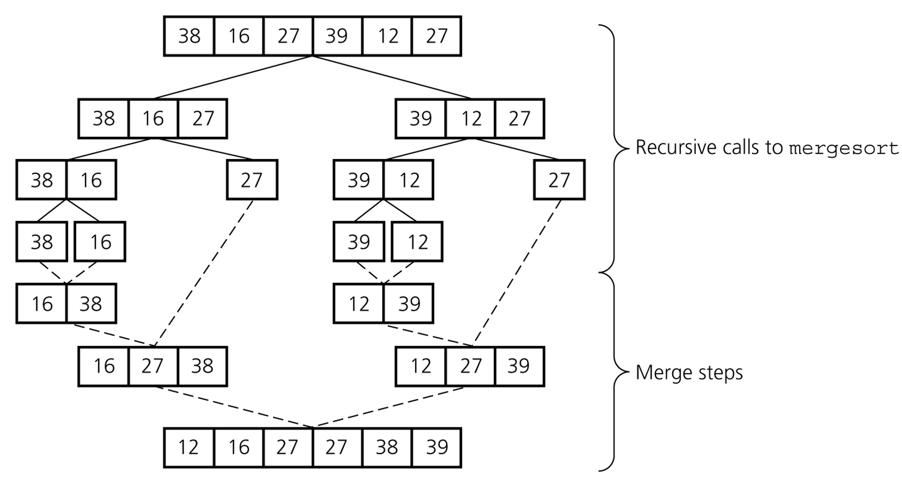
Mergesort – Example2
CS202 - Fundamentals of Computer Science II

Slide 39
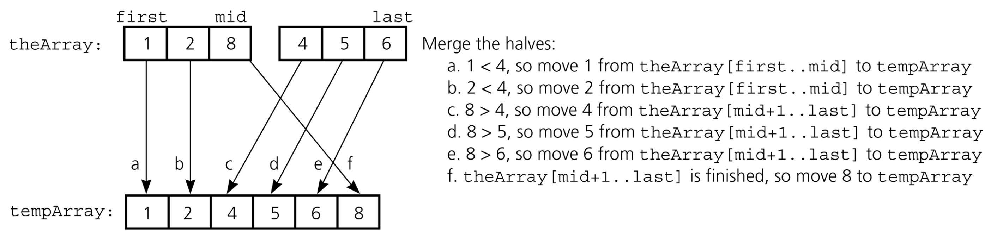
Mergesort – Analysis of Merge
A worst-case instance of the merge step in mergesort
CS202 - Fundamentals of Computer Science II

Slide 40
Mergesort – Analysis of Merge (cont.)
0 k-1
0 k-1
Merging two sorted arrays of size k
Best-case:
  All the elements in the first array are smaller (or larger) than all the elements in the second array.
  The number of moves: 2k + 2k
  The number of key comparisons: k
Worst-case:
  The number of moves: 2k + 2k
  The number of key comparisons: 2k-1
 | ..........
 | ..........
0 2k-1
 | ..........
CS202 - Fundamentals of Computer Science II

Slide 41
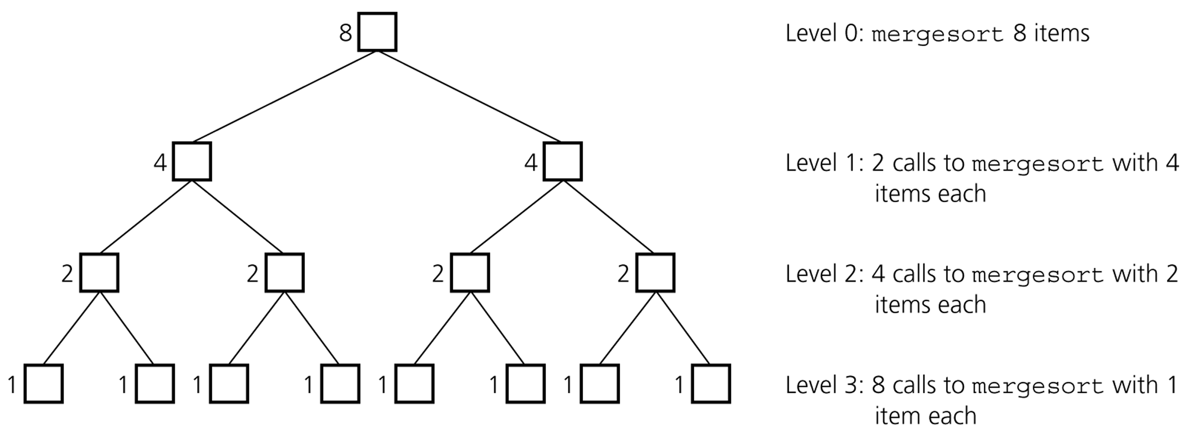
Mergesort - Analysis
Levels of recursive calls to mergesort, given an array of eight items
CS202 - Fundamentals of Computer Science II

Slide 42
Mergesort - Analysis
2^{m}
level 0 : 1 merge (size 2^{m-1})
2^{m-1}
2^{m-1}
level 1 : 2 merges (size 2^{m-2})
level 2 : 4 merges (size 2^{m-3})
2^{m-2}
2^{m-2}
2^{m-2}
2^{m-2}
.
.
.
.
.
.
level m-1 : 2^{m-1} merges (size 2⁰)
2⁰
2⁰
. . . . . . . . . . . . . . . . .
level m
CS202 - Fundamentals of Computer Science II

Slide 43
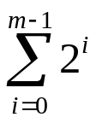
Mergesort - Analysis
Worst-case –
The number of key comparisons:
= 2⁰*(2*2^{m-1}-1) + 2¹*(2*2^{m-2}-1) + ... + 2^{m-1}*(2*2⁰-1)
= (2^{m} - 1) + (2^{m} - 2) + ... + (2^{m} – 2^{m-1}) ( m terms )
= m*2^{m} –
= m*2^{m} – 2^{m} – 1
= n * log₂n – n – 1
➔ O (n * log₂n )
CS202 - Fundamentals of Computer Science II

Slide 44
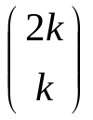

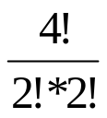
Mergesort – Average Case
There are possibilities when sorting two sorted lists of size k.
k=2 ➔ = = 6 different cases
# of key comparisons = ((2*2)+(4*3)) / 6 = 16/6 = 2 + 2/3
Average # of key comparisons in mergesort is
n * log₂n – 1.25*n – O(1)
➔ O (n * log₂n )
CS202 - Fundamentals of Computer Science II

Slide 45
Mergesort – Analysis
Mergesort is extremely efficient algorithm with respect to time.
  Both worst case and average cases are O (n * log₂n )
But, mergesort requires an extra array whose size equals to the size of the original array.
If we use a linked list, we do not need an extra array
  But, we need space for the links
  And, it will be difficult to divide the list into half ( O(n) )
CS202 - Fundamentals of Computer Science II

Slide 46
Quicksort
CS202 - Fundamentals of Computer Science II

Slide 47
Quicksort
Like Mergesort, Quicksort is based on divide-and-conquer paradigm.
But somewhat opposite to Mergesort
  Mergesort: Hard work done after recursive call
  Quicksort: Hard work done before recursive call
Algorithm
  First, partition an array into two parts,
  Then, sort each part independently,
  Finally, combine sorted parts by a simple concatenation.
CS202 - Fundamentals of Computer Science II

Slide 48
Quicksort (cont.)
The quick-sort algorithm consists of the following three steps:
Divide: Partition the list.
  1.1 Choose some element from list. Call this element the pivot.
  - We hope about half the elements will come before and half after.
  1.2 Then partition the elements so that all those with values less than the pivot come in one sublist and all those with greater values come in another.
2. Recursion: Recursively sort the sublists separately.
3. Conquer: Put the sorted sublists together.
CS202 - Fundamentals of Computer Science II

Slide 49
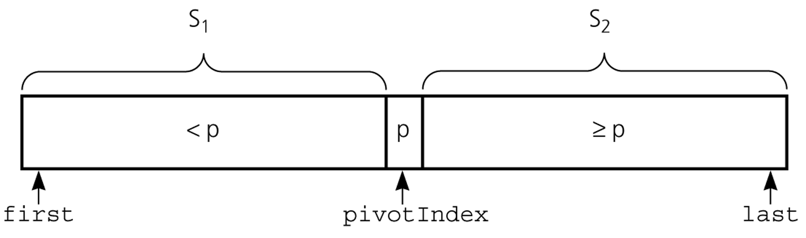
Partition
Partitioning places the pivot in its correct place position within the array.
Arranging elements around pivot p generates two smaller sorting problems.
  sort left section of the array, and sort right section of the array.
  when these two smaller sorting problems are solved recursively, our bigger sorting problem is solved.
CS202 - Fundamentals of Computer Science II

Slide 50
Partition – Choosing the pivot
First, select a pivot element among the elements of the given array, and put pivot into first location of the array before partitioning.
Which array item should be selected as pivot?
  Somehow we have to select a pivot, and we hope that we will get a good partitioning.
  If the items in the array arranged randomly, we choose a pivot randomly.
  We can choose the first or last element as a pivot (it may not give a good partitioning).
  We can use different techniques to select the pivot.
CS202 - Fundamentals of Computer Science II

Slide 51
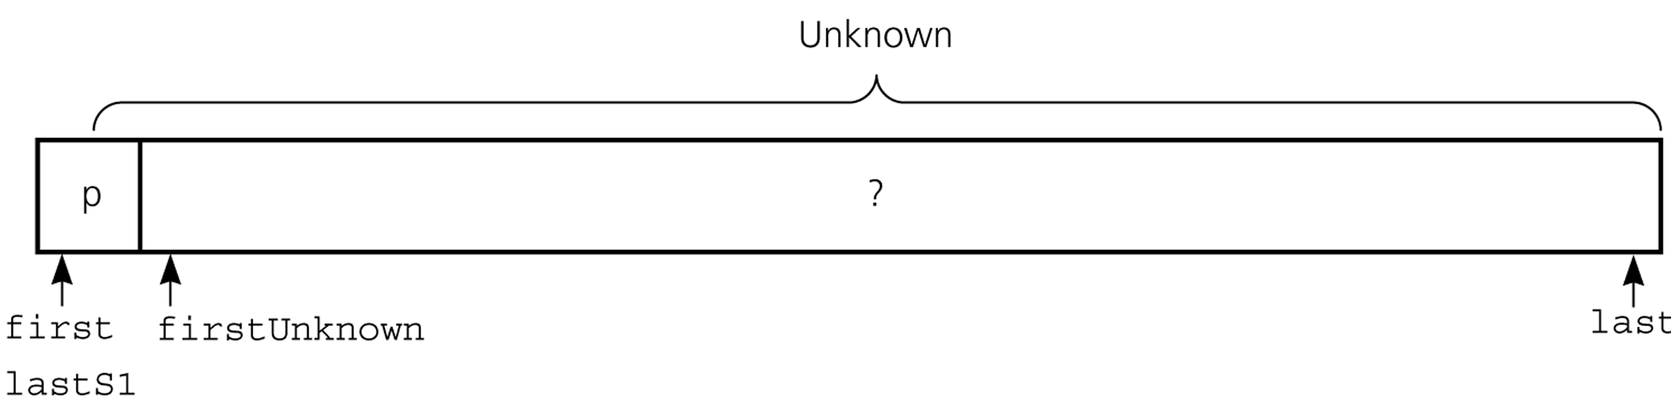
Partition Function (cont.)
Initial state of the array
CS202 - Fundamentals of Computer Science II

Slide 52
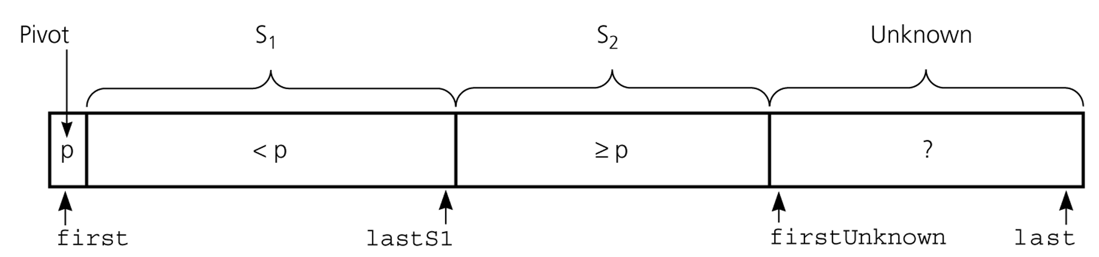
Partition Function (cont.)
Invariant for the partition algorithm
CS202 - Fundamentals of Computer Science II

Slide 53
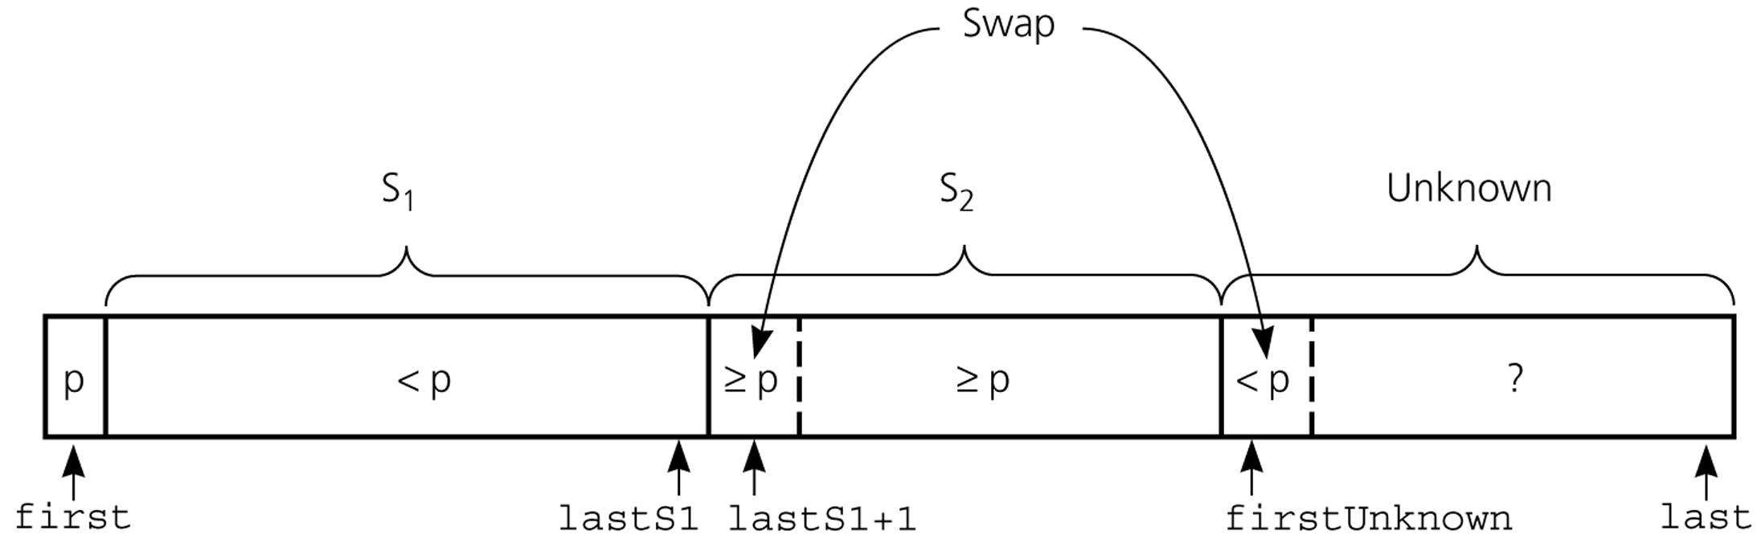
Partition Function (cont.)
Moving theArray[firstUnknown] into S₁ by swapping it with
theArray[lastS1+1] and by incrementing both lastS1 and firstUnknown.
CS202 - Fundamentals of Computer Science II

Slide 54
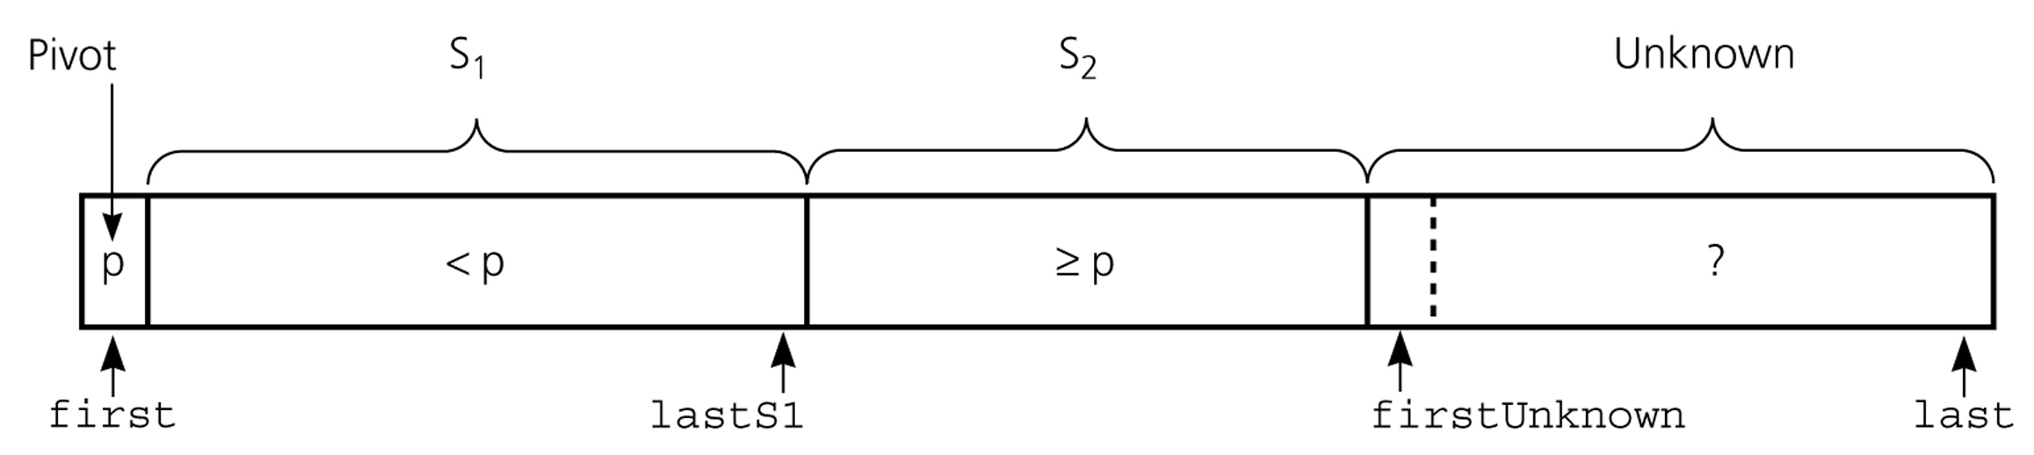
Partition Function (cont.)
Moving theArray[firstUnknown] into S₂ by incrementing firstUnknown.
CS202 - Fundamentals of Computer Science II

Slide 55
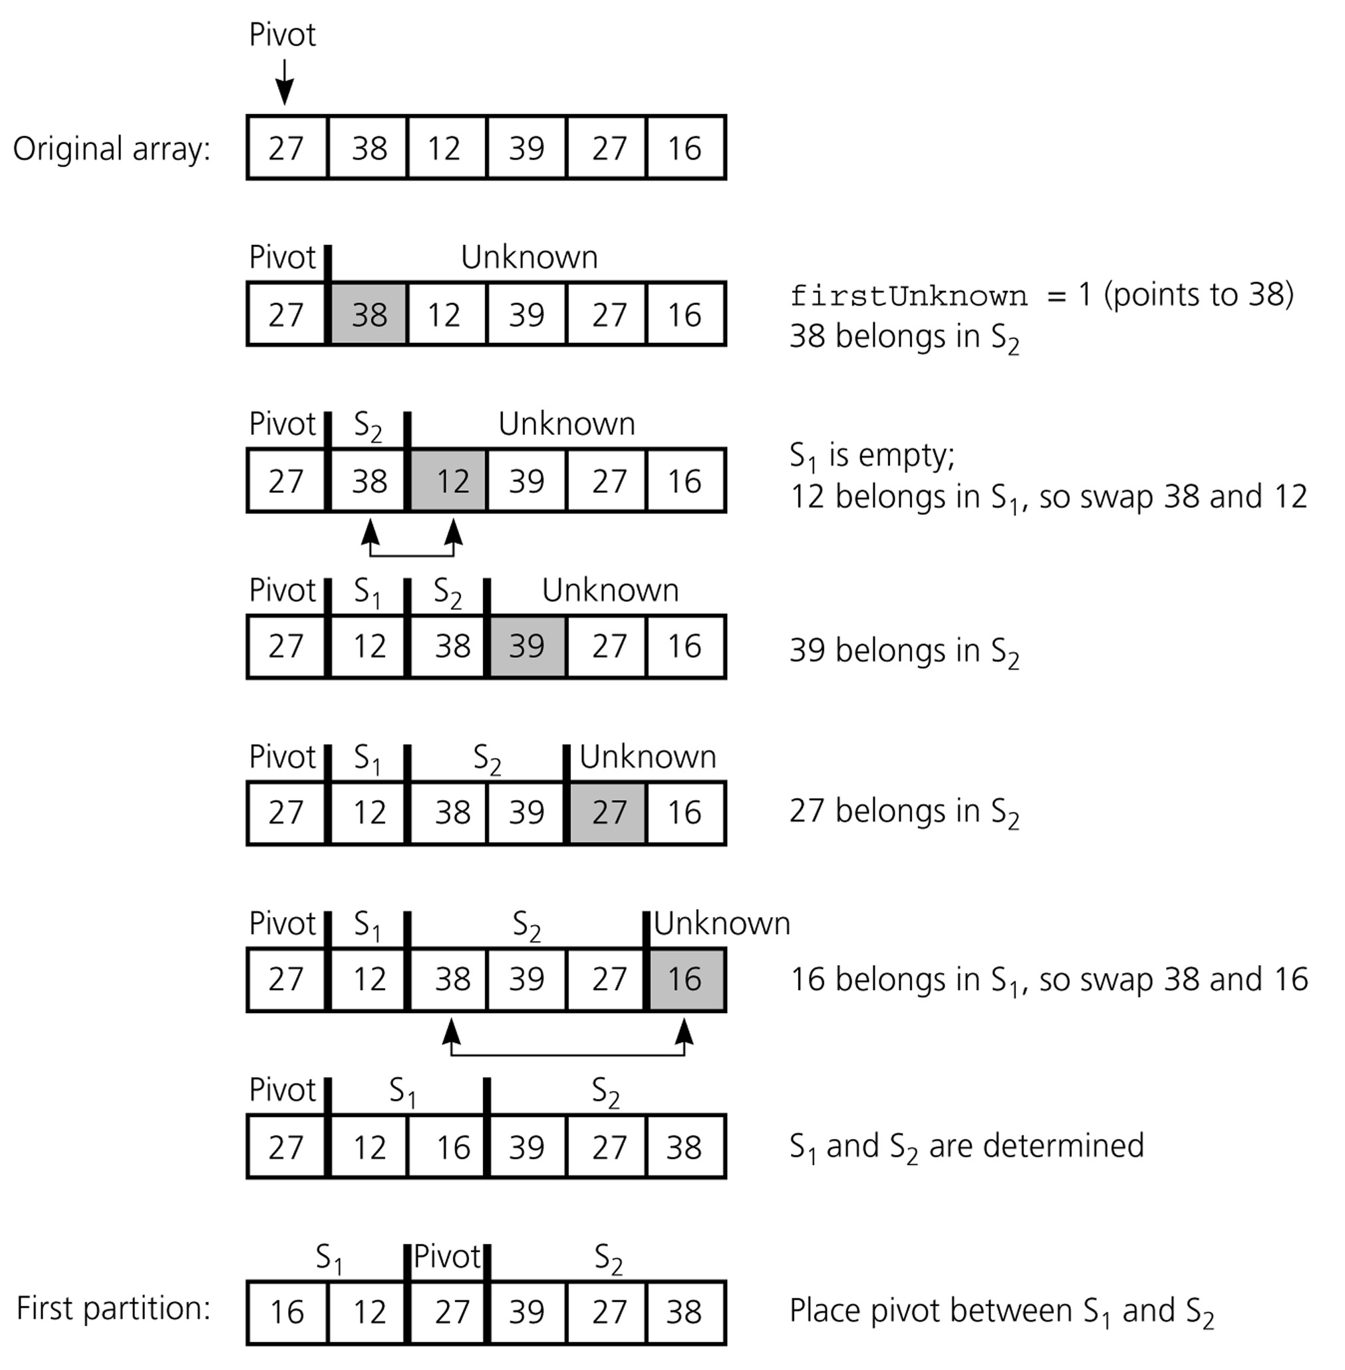
Partition Function (cont.)
Developing the first
partition of an array
when the pivot is the
first item
CS202 - Fundamentals of Computer Science II

Slide 56
Quicksort Function
void quicksort(DataType theArray[], int first, int last) {
// Precondition: theArray[first..last] is an array.
// Postcondition: theArray[first..last] is sorted.
int pivotIndex;
if (first < last) {
// create the partition: S1, pivot, S2
partition(theArray, first, last, pivotIndex);
// sort regions S1 and S2
quicksort(theArray, first, pivotIndex-1);
quicksort(theArray, pivotIndex+1, last);
}
}
CS202 - Fundamentals of Computer Science II

Slide 57
Partition Function
void partition(DataType theArray[], int first, int last,
int &pivotIndex) {
// Precondition: theArray[first..last] is an array; first <= last.
// Postcondition: Partitions theArray[first..last] such that:
// S1 = theArray[first..pivotIndex-1] < pivot
// theArray[pivotIndex] == pivot
// S2 = theArray[pivotIndex+1..last] >= pivot
// place pivot in theArray[first]
choosePivot(theArray, first, last);
DataType pivot = theArray[first]; // copy pivot
…
CS202 - Fundamentals of Computer Science II

Slide 58
Partition Function (cont.)
// initially, everything but pivot is in unknown
int lastS1 = first; // index of last item in S1
int firstUnknown = first + 1; // index of first item in unknown
// move one item at a time until unknown region is empty
for ( ; firstUnknown <= last; ++firstUnknown) {
// Invariant: theArray[first+1..lastS1] < pivot
// theArray[lastS1+1..firstUnknown-1] >= pivot
// move item from unknown to proper region
if (theArray[firstUnknown] < pivot) { // belongs to S1
++lastS1;
swap(theArray[firstUnknown], theArray[lastS1]);
} // else belongs to S2
}
// place pivot in proper position and mark its location
swap(theArray[first], theArray[lastS1]);
pivotIndex = lastS1;
}
CS202 - Fundamentals of Computer Science II

Slide 59
Quicksort – Analysis
Worst Case: (assume that we are selecting the first element as pivot)
The pivot divides the list of size n into two sublists of sizes 0 and n-1.
The number of key comparisons
  = n-1 + n-2 + ... + 1
  = n²/2 – n/2 ➔ O(n²)
The number of swaps =
  = n-1 + n-1 + n-2 + ... + 1
  swaps outside of the for loop swaps inside of the for loop
  = n²/2 + n/2 - 1 ➔ O(n²)
So, Quicksort is O(n²) in worst case
CS202 - Fundamentals of Computer Science II

Slide 60
Quicksort – Analysis
Quicksort is O(n*log₂n) in the best case and average case.
Quicksort is slow when the array is already sorted and we choose the first element as the pivot.
Although the worst case behavior is not so good, and its average case behavior is much better than its worst case.
  So, Quicksort is one of best sorting algorithms using key comparisons.
CS202 - Fundamentals of Computer Science II

Slide 61
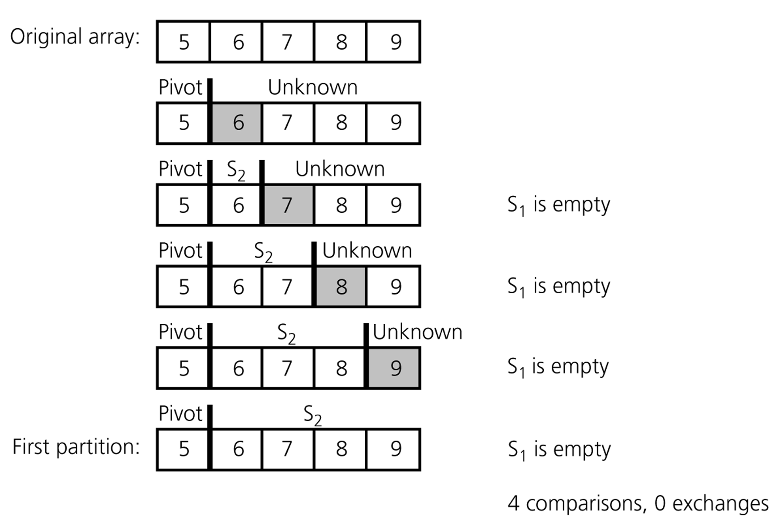
Quicksort – Analysis
A worst-case partitioning with quicksort
CS202 - Fundamentals of Computer Science II

Slide 62
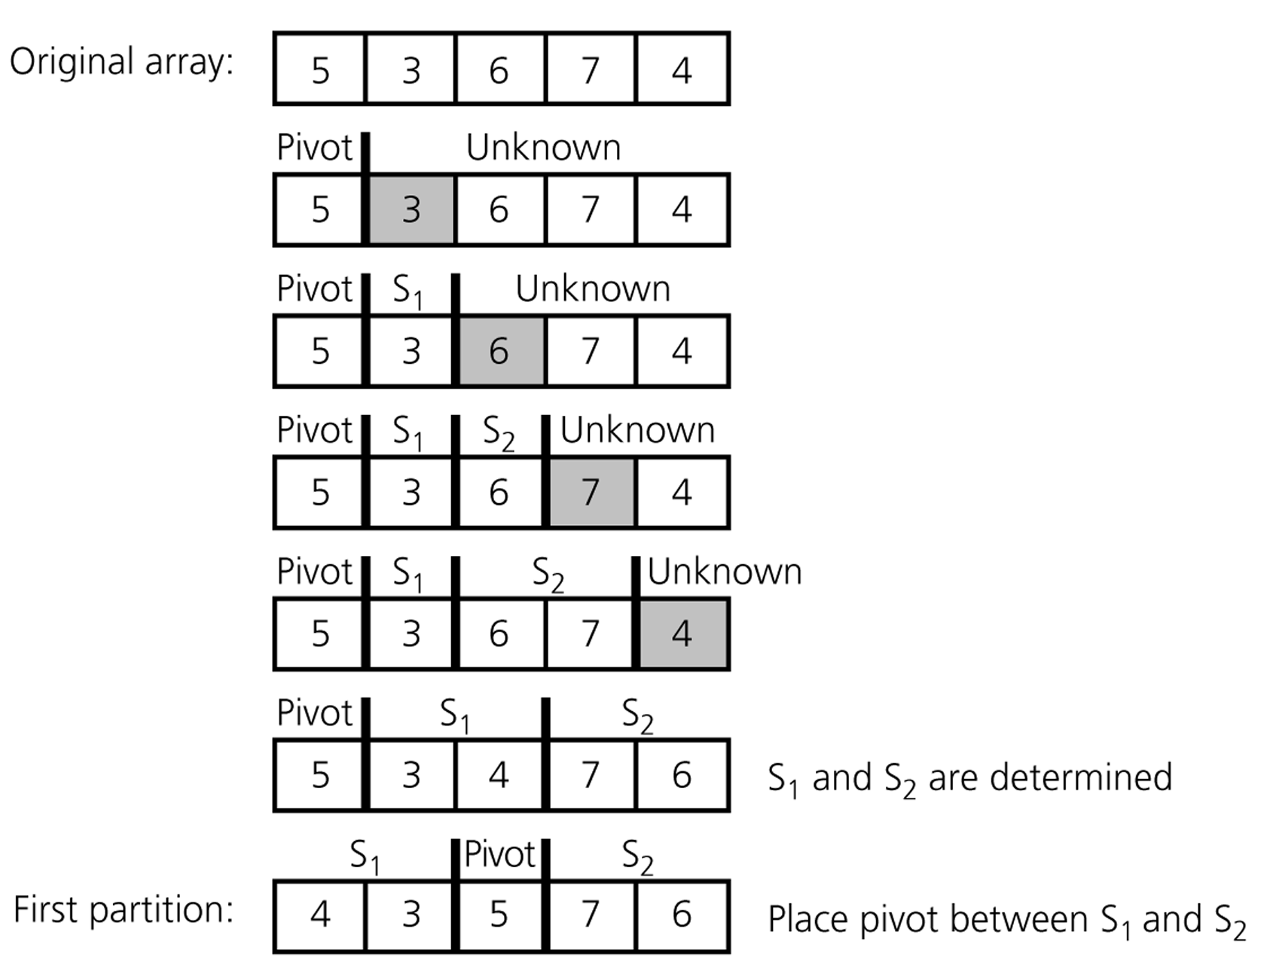
Quicksort – Analysis
An average-case partitioning with quicksort
CS202 - Fundamentals of Computer Science II

Slide 63
Other Sorting Algorithms?
CS202 - Fundamentals of Computer Science II

Slide 64
Other Sorting Algorithms?
Many! For example:
Shell sort
Comb sort
Heapsort
Counting sort
Bucket sort
Distribution sort
Timsort
e.g. Check http://en.wikipedia.org/wiki/Sorting_algorithm for a table comparing sorting algorithms.
CS202 - Fundamentals of Computer Science II

Slide 65
Radix Sort
Radix sort algorithm different than other sorting algorithms that we talked.
  It does not use key comparisons to sort an array.
The radix sort :
  Treats each data item as a character string.
  First group data items according to their rightmost character, and put these groups into order w.r.t. this rightmost character.
  Then, combine these groups.
  Repeat these grouping and combining operations for all other character positions in the data items from the rightmost to the leftmost character position.
  At the end, the sort operation will be completed.
CS202 - Fundamentals of Computer Science II

Slide 66
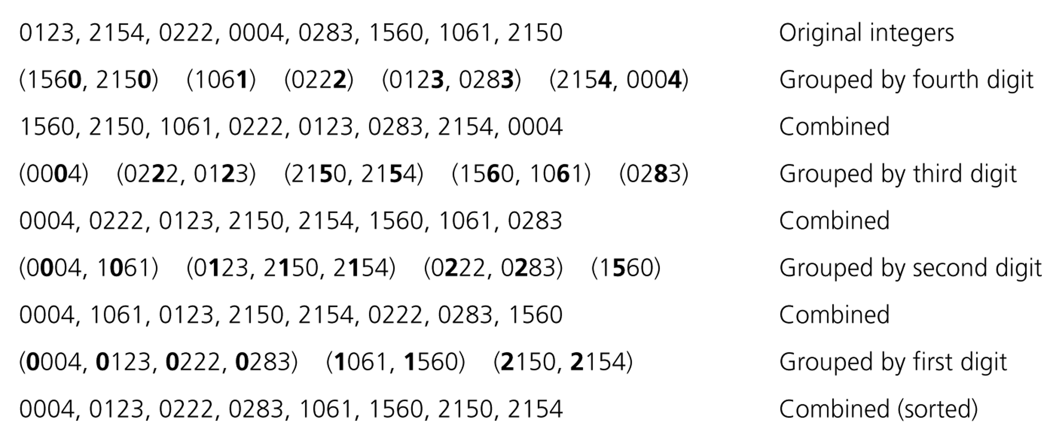
Radix Sort – Example
CS202 - Fundamentals of Computer Science II

Slide 67
Radix Sort – Example
mom, dad, god, fat, bad, cat, mad, pat, bar, him original list
(dad,god,bad,mad) (mom,him) (bar) (fat,cat,pat) group strings by rightmost letter
dad,god,bad,mad,mom,him,bar,fat,cat,pat combine groups
(dad,bad,mad,bar,fat,cat,pat) (him) (god,mom) group strings by middle letter
dad,bad,mad,bar,fat,cat,pat,him,god,mom combine groups
(bad,bar) (cat) (dad) (fat) (god) (him) (mad,mom) (pat) group strings by middle letter
bad,bar,cat,dad,fat,god,him,mad,mom,par combine groups (SORTED)
CS202 - Fundamentals of Computer Science II

Slide 68
Radix Sort - Algorithm
radixSort( int theArray[], in n:integer, in d:integer)
// sort n d-digit integers in the array theArray
for (j=d down to 1) {
Initialize 10 groups to empty
Initialize a counter for each group to 0
for (i=0 through n-1) {
k = jth digit of theArray[i]
Place theArray[i] at the end of group k
Increase kth counter by 1
}
Replace the items in theArray with all the items in
group 0, followed by all the items in group 1, and so on.
}
CS202 - Fundamentals of Computer Science II

Slide 69
Radix Sort -- Analysis
The radix sort algorithm requires 2*n*d moves to sort n strings of d characters each.
➔ So, Radix Sort is O(n)
Although the radix sort is O(n), it is not appropriate as a general-purpose sorting algorithm.
  Its memory requirement is d * original size of data (because each group should be big enough to hold the original data collection.)
  For example, to sort string of uppercase letters. we need 27 groups.
  The radix sort is more appropriate for a linked list than an array. (we will not need the huge memory in this case)
CS202 - Fundamentals of Computer Science II

Slide 70
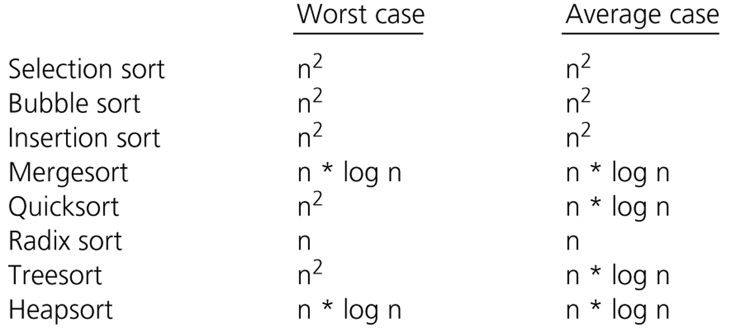
Comparison of Sorting Algorithms
CS202 - Fundamentals of Computer Science II

